Slide 1


CSE445/598
Distributed Software Development
Performance of
Multithreading and Multi-Core Computing
Yinong Chen (Ph.D.)
http://www.public.asu.edu/~ychen10/teaching/cse445/index.html

Slide 2
Outline of the Lecture
Archtecture: HyperThreading and Multi-core processors
Software support of making use of the power of multi-core processors
Performance indicators: Speedup and efficiency
Demo: Horse Power Game under Multi-Core
Case Study: Multithreading Performance Experiment Using Intel Many-core Testing Lab (32-Core Computer)

Slide 3
Multithreading and Multi-Core Architecture
Single-Threading:
Serial execution - One thread at a time.
Multithreading on Single Core
Multiple threads executed on one processor by using context switching.
HyperThreading Architecture (Hardware-level):
Two threads execute simultaneously on the same processor with additional threading logic.
Multi-Core Architecture:
Threads are distributed among the cores with True Parallel Computing
The benefit of threading will be limited

Slide 4
Single Core and HyperThreading Processor
Control Unit
Registers
Interrupt Logic
Single Core Processor
Execution Units
Integer ALU
Float ALU
Cache
It appears to OS to have two processors, resulting two threads are assigned to the processor. Executing two mixed threads will reduce instruction dependency for pipelined processor!
HyperThreading Processor: Allows to share the unused execution units
Control Unit
Registers
Interrupt Logic
Control Unit
Registers
Interrupt Logic
Execution Units
Integer ALU
Float ALU
Cache

Slide 5
Multi-Core and HyperThreading Processor
Control Unit
Registers
Interrupt Logic
Control Unit
Registers
Interrupt Logic
Execution Units
Execution Units
Integer ALU
Float ALU
Cache
Integer ALU
Float ALU
Cache
Multi-Core
Control Unit
Registers
Interrupt Logic
Control Unit
Registers
Interrupt Logic
Control Unit
Registers
Interrupt Logic
Control Unit
Registers
Interrupt Logic
Execution Units
Execution Units
Integer ALU
Float ALU
Cache
Integer ALU
Float ALU
Cache
Multi-Core with HyperThreading

Slide 6
Utilization of Multi-Core Processors
People are always running multiple applications when they use their computer.
Tasks are automatically distributed to different cores, and thus multi-cores are always useful.
The issue is, if one has a critical (serial) application and wants to get the computation done as quick as possible, one would close all other applications. In this case, ONE CORE will be used only.
How can this problem be addressed, with support from the development environment?
Java and C# have built-in support of multithreading
What about C and C++?

Slide 7
Intel Software Support to Multi-Core
http://software.intel.com/en-us/articles/optimizing-game-architectures-with-intel-threading-building-blocks/
One solution Intel offers: Intel® Threading Building Blocks (Intel® TBB)
TBB is a set of library functions primarily designed for optimizing computation-intensive applications, such as graphics processing in gaming.
TBB can enhance the performance of these applications with relatively small amounts of coding effort.
Even for a serial application, TBB techniques demonstrate straightforward ways of introducing performance threading.

Slide 8
Key Ideas of Intel® TBB
http://software.intel.com/en-us/articles/optimizing-game-architectures-with-intel-threading-building-blocks/
Improve parallel computing possibility by:
Turning synchronous (blocking) calls into asynchronous (non-blocking) calls using even-driven programming paradigm.
Converting nested (vertical) method calls (threads) into flat method calls.

Slide 9
Synchronous Calls of a Large Thread
Caller spawns
Caller Waits
Entry Point / Root
Method calls
Task processing
Task processing
Task processing
Method calls
Task processing
Task processing
Task processing

Slide 10
TBB Asynchronous Call on Smaller Thread
Root node will not be created
Caller spawns
without Waiting
Entry Point / Root
eventAlert
Task processing
Task processing
Task processing
doCallback
Task processing
Make the second call
Task processing
Task processing
void doCallback(FunctionPointer fCallback, void *pParam) // C++ code
{
// allocation with "placement new" syntax, see TBB reference documents
CallbackTask *pCallbackTask = new(
s_pCallbackRoot->allocate_additional_child_of(*s_pCallbackRoot)
) CallbackTask(fCallback, pParam);
s_pCallbackRoot->spawn(*pCallbackTask);
}

Slide 11
Creating a Root for Sync Calls
In many cases, sync calls are still wanted, and it is then advantageous to have a root, which keeps track of asynchronous calls and explicitly waits for them to complete.
TBB uses a Promise system: When handling a request for asynchronous execution, the promise system provides the calling thread an object that acts as a link to the asynchronous call.
This Promise object allows the calling thread to wait on the asynchronous call when necessary.

Slide 12
TBB Sync Calls with Promise System
The root is encapsulated in lib function Promise. It starts if necessary: When the promise has a Mutex.Wait for it.
Wait with Mutex
Promise
Mutex.Wait
Entry Point / Root
Caller spawns
without Waiting
eventAlert
Task processing
Task processing
Task processing
doCallback
Task processing
Task processing
Task processing

Slide 13
C++ Code Implementing Promise & Wait
void doPromise(FunctionPointer fCallback, void *pParam, Promise *pPromise) {
// allocation with "placement new" syntax, see TBB reference documents
tbb::task *pParentTask = new(tbb::task::allocate_root()) tbb::empty_task();
assert(pPromise != NULL);
pPromise->setRoot(pParentTask);
PromiseTask *pPromiseTask = new(pParentTask->allocate_child()) PromiseTask(fCallback, pParam, pPromise);
// set ref count to 2, which accounts for the 1st child and eventually wait_for_all
pParentTask->set_ref_count(2);
pParentTask->spawn(*pPromiseTask);
}
void waitUntilDone() {
if(m_pRoot != NULL) {
// mutex lock up access to one-at-a-time
tbb::spin_mutex::scoped_lock(m_tMutex);
if(m_pRoot != NULL) {
m_pRoot->wait_for_all();
m_pRoot->destroy(*m_pRoot);
m_pRoot = NULL;
} } }
A mutex is introduced here to ensure that the waitUntilDone call is thread-safe.
If waitUntilDone will be called by only one thread (the thread that submitted the asynchronous call), this additional mutex is not necessary.

Slide 14
Other Solutions of Improving Performance
For examples:
OpenMP (Open Multi-Processing) is an API that supports multi-platform shared memory multiprocessing programming in C, C++ and Fortran on many architectures. It consists of a set of compiler directives, library routines, and environment variables that influence run-time behavior [http://en.wikipedia.org/wiki/OpenMP].
Pthreads (POSIX Threads) define a set of C library types, functions and constants that can be used for improving threading performance.
Visual Studio uses Generic Class to enable parallel computing in C++ (Ref. Chen: Introduction to Programming Languages)

Slide 15
Performance Metrics of Multithreading
Speedup of a program: The ratio of the serial execution time to the parallel execution time
SerialExecutionTime(P)
Speedup (P) =
ParallExecutionTime(P)
8
7
6
5
4
3
2
1
Perfect scalability
speedup
Good scalability
Poor scalability
1
2
3
4
5
6
7
8
Number of cores

Slide 16
Amdahl’s Law (Review)
An N-core design cannot improve the speed of all components in the system by a fact or N.
Assume that f fraction of the system is enhanced by the factor N
SerialExecTime
ParallelExecTime
Speedup =
SerialExecTime
(f x SerialExecTime)/N + (1 – f ) x SerialExecTime
=
1
f /N + (1 – f )
=

Slide 17
Example: Salability of N-Core
1
f /s + (1 – f )
Speedup (f, N) =
Assume f = 0.9 and N = 10, 100, and 1000
1
Speedup (0.9, N=10) = = 5.3
0.9/10 + 0.1
1
Speedup (0.9, N = 100 ) = = 9.1
0.9/100 + 0.1
Speedup (0.9, N = 1000 ) = 9.9

Slide 18
Gustafson's Law, with a Different Assumption
Amdahl’s Law assumes the fraction 1- f of the serial computing part does not change when multiple cores are added. As the result, the unchanged part will become the bottle-neck, no matter how big the N is.
Gustafson's Law assumes that the fraction 1- f of the serial computing part will be improved proportionally when multiple cores are added, and thus:
speedup(f, N) = N – f (N – 1)
For Assume f = 0.9 and N = 10, 100, and 1000
f | N | Speedup = N – f (N – 1)
0.9 | 10 | 1.9
0.9 | 100 | 10.9
0.9 | 1000 | 100.9

Slide 19
Efficiency of Multi-Core Processors
Speedup measures how much faster the parallel execution than the serial execution
Efficiency measures how well the multi-core resources are utilized.
Assume the number of cores is N and the speedup is S, relative to a single core implementation when executing program P
S(P)
Efficiency(P) =
N

Slide 20


Intel Multithreading Demos on Multi-Cores
Games with extensive graphics rendering are computing extensive;
These demos show the efficiency of multithreading
Horse Power: How many horses an eight-core processor can render, when N threads are used for N = 1, 2, 4, and 8
Destroy the Castle: Show the falling down of castle when being destroyed
Demos links at:
http://software.intel.com/en-us/videos/intel-horsepower-demo-sigcse-2010/
http://software.intel.com/en-us/videos/destroy-the-castle-demo-at-gdc-austin/

Slide 21
Performance Measurements Using Many (32) Core Processor
Case Study:
Experiment Design and Implementation Considerations

Slide 22
Validating Famous Conjectures
A conjecture is a proposition or theorem that appears correct and has not been proven or disproven.
Finding counterexample is to disprove.
P ≠ NP
Beal's conjecture (1993): Assume A, B, C are positive integers, and x, y, z > 2. If A^{x} + B ^{y} = C ^{z}, then, A, B, and C must have a common prime factor. Beal offers US$100K prize for a proof or a counterexample.
Goldbach's Conjecture (1742): Every even integer greater than 2 can be expressed as the sum of two primes.
Collatz conjecture (1937): About program correctness

Slide 23
Verifying Program Correctness
Program’s total correctness is defined by two aspects
Partial correctness: For every valid input, the program gives correct output. Different methods exist:
Induction
Symbolic execution
Other methods
Termination: For every valid input, the program terminates in limited steps (or limited time)
Loop variable must decrease strictly

Slide 24
Collatz Conjecture (Half Or Triple Plus One)
The Collatz conjecture: proposed by Collatz in 1937.
Take any natural number n. If n is even, divide it by 2 to get n / 2; if n is odd, multiply it by 3 and add 1 to obtain 3n + 1. Repeat the process until the result is 1.
The conjecture is that no matter what number you start with, you will always reach 1 –– the program always terminates.
We will write a multithreading program to validate the Collatz Conjecture or find a counterexample. We want to use 32-core computer to outperform many efforts people have started running years ago: Our one year could be worth of other’s 32 years!

Slide 25
Case Study: Efficiency Issues in Multithreading
Because the overhead of creating and starting multithreading, the speedup S of N parallel threads will be S < N.
If the overhead is so large, it is possible S < 1, meaning that the multiple threading program is slower than the single threaded program.
When comparing multiple threading program with the single threaded program, the implementations of the two programs must be fair (not biased).

Slide 26
The method to be started as a thread
class HOTPO { //Collatz conjecture: Half Or Triple Plus One
Int64 s, t;
public HOTPO(Int64 start, Int64 terminate) {
this.s = start;
this.t = terminate;
}
public void hotpoFunc() {
for (Int64 i = 1; i <= t; i++) {
Int64 n = i;
while (n > 1) {
if (n % 2 == 0) // if n is even, divide by 2
n = n / 2; // Integer division
else
n = 3 * n + 1; // Multiply 3 and plus 1
}
}
}
}
This function validate all number between start and terminate

Slide 27
Experiment Design for a Core 2 Qua Computer
Creating 4 threads
Each thread processes one fourth of the numbers
All number from 1 to 4m
1
m+1
2m+1
3m+1
4m
Thread 1
Thread 2
Thread 3
Thread 4
There is no communication and coordination among the threads to maximize the speedup.

Slide 28
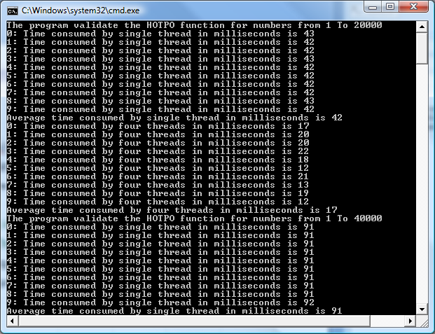
Output (Part)

Slide 29
Speedup and Efficiency on 4-Core Processor
on Intel Core 2 Quad CPU @2.40 GHz
Input Size | One thread | Four Thread | Speedup | Efficiency
20,000 | 41 | 20 | 2.05 | 51%
40,000 | 89 | 33 | 2.70 | 67%
60,000 | 139 | 49 | 2.84 | 71%
80,000 | 191 | 62 | 3.08 | 77%
100,000 | 246 | 88 | 2.80 | 70%
120,000 | 300 | 97 | 3.09 | 77%
140,000 | 359 | 101 | 3.55 | 89%
160,000 | 414 | 119 | 3.48 | 87%
180,000 | 472 | 149 | 3.17 | 79%
200,000 | 513 | 153 | 3.35 | 84%
Average Speedup = 3.01
Time in milliseconds
Efficiency = Speedup / Cores
Average Efficiency = 75%

Slide 30
Speedup and Efficiency Observation on 4 Cores
The bigger the problem is, the more efficient are the multi-core and multithreading techniques.
The curves are not straight, as other tasks are running on the computer
The growth slows down when the problem is too big
On single core
On four cores
Collatz conjecture validation execution time, speedup, and efficiency with different problem sizes

Slide 31
Further Experiment on Intel 32-Core MTL
http://software.intel.com/en-us/articles/intel-many-core-testing-lab/
40 cores in 2013
Questions to explore
What would happen if we make use of more cores by increasing the number of parallel threads?
Can the execution time, speedup, and efficiency improve proportionally to the number of cores?
What are overheads by increasing the number of threads?
Experiments
The same program is executed in 1, 4, 8, 16, and 32 threads on the 32-core machine in Intel Many-core Testing Lab (MTL);
The times are measured, and speedup and efficiency are calculated

Slide 32
Experiment Design for a 32-Core Computer Attempt 1
Creating 1, 4, 8, 16, 32 threads
Each thread takes a part (1milliom) of the numbers. For 32 threads:
Map
Reduce
. . .
1
32m
Thread 1
Thread 3
Thread 4
Thread 5
Thread 6
Thread 7
Thread 8
Thread 10
Thread 11
Thread 2
Thread 9
Thread 12
Thread 14
Thread 32
Thread 13
. . .
Spin Synchronization
Reduce
Conclusion: Find a solution or not

Slide 33
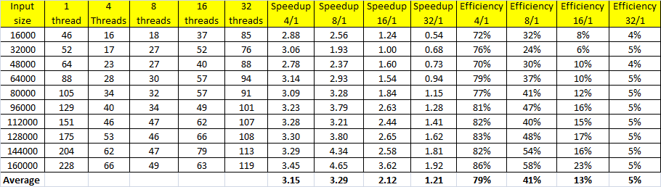
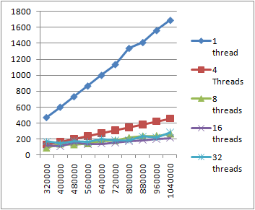
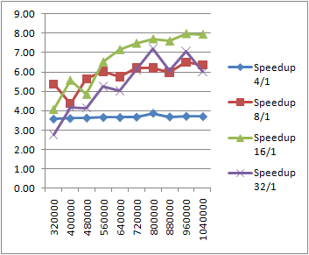
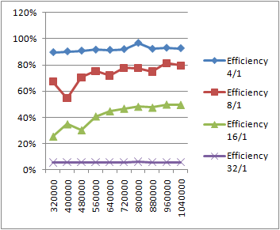
Experiment Data From Attempt 1
Time measured in milliseconds
Speedup
Efficiency
Input
size

Slide 34
Performance: of the 32-Core Attempt 1
The 4-thread performance (3.15 – 79%) of the 32-core is slightly better that on the 4-core (Core 2 Qua).
The 8-thread performance is the highest (3.29 – 41%), but the efficiency is 41% only.
The 16-thread performance is much worse, and 32-core performance is the worst.
What is wrong?
The simple partition is to blame:
The first subset has all the small numbers, while the last subset has all the large number;
The slowest thread counts for the performance.

Slide 35
Experiment Design for a 32-Core Computer Attempt 1
Creating 32 threads, each thread compute 1/32 of the numbers.
1st million
2nd million
3rd million
31st million
32nd million
Thread 1
Thread 2
Thread 3
Thread 31
Thread 32
Spin & wait for all threads to complete
Spin Synchronization
Conclusion: Find a solution or not

Slide 36
Using Modulo Operation for Input Partition Attempt 2
To give each thread balanced numbers (mix of small and large), we use modulo operation;
We use N arrays (0.. N-1) to store the numbers to be validated;
One thread program uses one array
32-threads use 32 arrays
The number with residue r goes into array r;

Slide 37
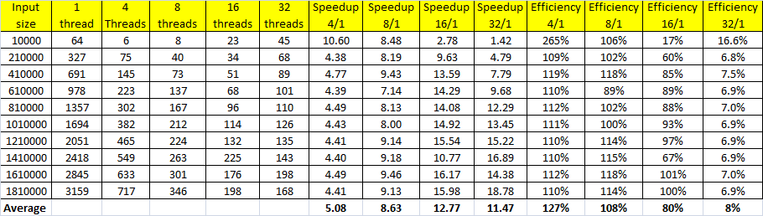
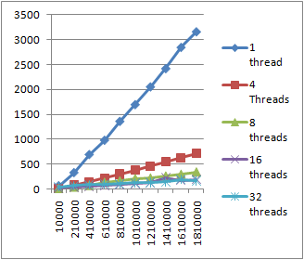
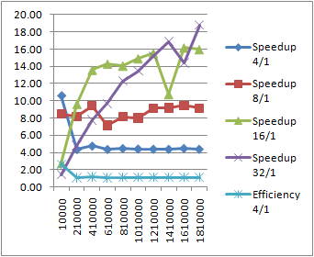
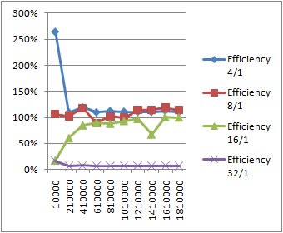
Experiment Data From Attempt 2
Time measured in milliseconds
Speedup
Efficiency
Input
size

Slide 38
Performance: of the 32-Core Attempt 2
The 4-thread performance (5.08 – 127%) against the 1-thread implementation.
The 8-thread performance is the highest (8.63 – 108%).
The 16-thread performance is the highest (12.77 - 80%).
What is wrong?
The single thread is unfairly implemented:
The single thread program uses a single large array;
The 32-thread program uses 32 smaller arrays;
The memory management of the system must have placed the large array far from the processor, resulting in slower data access. Data structure impact dominates.

Slide 39
Performance: of the 32-Core Attempt 3 The Final Version
To be fair to all implementations, we use 32 arrays no matter the number of threads
32 arrays for one-thread program
List of arrays stored
partitioned numbers
One Thread
All numbers to be validated
Thread 1
Store in 32 arrays
. . .

Slide 40
Performance: of the 32-Core Attempt 3 The Final Version
32 arrays for 32 threads
List of arrays stored
partitioned numbers
Number mod T
Single-thread implementation
1
Switch
1
All numbers to be validated
2
. . .
. . .
Input Partition
T
Multithread implementation

Slide 41
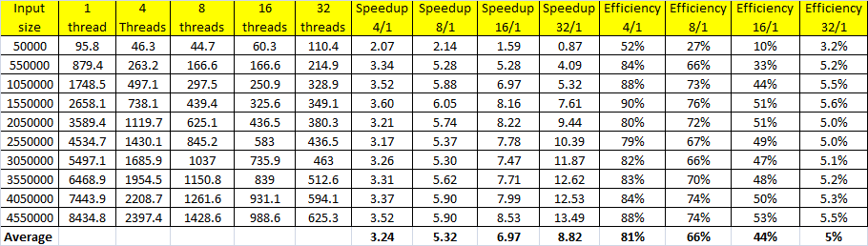
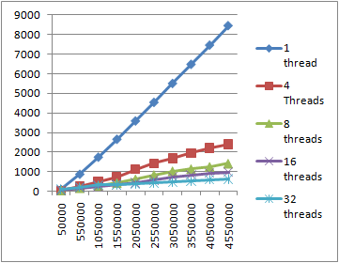
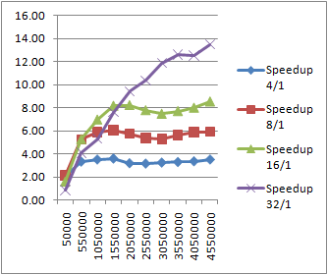
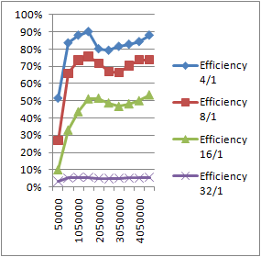
Experiment Results on Intel 32-Core MTL
The Final Version
Time measured in milliseconds
Speedup
Efficiency
Input
size

Slide 42
Analysis of the Experiment Results
Fair implementations are critical for comparison
Execution Time Measured
Increasing threads makes use of more cores and reduces the execution time;
The overhead can exceed the time saved by parallel execution once the thread number becomes too big.
The bigger the input size is, the more time is saved.
Speedup (improvement against single thread)
The trend is similar to execution
Efficiency
Due to the overhead added by managing multithreading, the more threads are used, the lower the efficiency.
The bigger the input size, the more efficient

Slide 43
The Complete Program (Attempt 3)
namespace Collatz {
class HOTPO {
List<Int64> vs;
public HOTPO(List<Int64> validationSet) {
vs = validationSet;
}
public void hotpoFunc() { //Collatz conjecture: Half Or Triple Plus One
foreach(Int64 e in vs) {
Int64 n = e;
while (n > 1) {
if (n % 2 == 0) // if n is even
n = n / 2; // Integer division
else
n = 3 * n + 1;
} } } }
The function of
Half Or Triple Plus One
The function of
Half Or Triple Plus One.
The function will be started as threads

Slide 44
The Program (Console Application)
Prepared for executing the program in multiple iterations for building average results
class Program {
static void Main(string[ ] args) {
Int64 repeatNo = 10;
for (Int64 k = 0; k <= 5; k++) { // threadnum = 1, 2, 4, 8, 16, 32
Int64 threadnum = (Int64)System.Math.Pow(2, k);
for (Int64 r = 1; r <= 100; r = r + 10) {
float totalTime = 0;
Int64 t = r * 50000; // define the step length of iteration
Console.Write("The program validate HOTPO function for numbers ");
Console.WriteLine("from 1 To " + t);
try {
HOTPO[] h = new HOTPO[32];
List<Int64>[] vSetList = new List<Int64>[32];
for (Int64 i = 1; i <= t; i++) {
if (vSetList[i % 32] == null)
vSetList[i % 32] = new List<Int64>();
vSetList[i % 32].Add(i);
}
Load the data into the list of arrays

Slide 45
Partition Inputs into a List of Array
Thread[] ht = new Thread[32]; // create 32 thread object
for (int i = 0; i < repeatNo; i++) {
DateTime startMT = DateTime.Now;
for (Int64 b = 0; b < threadnum; b++) {
for (Int64 count = 0; count < (Int64)System.Math.Pow(2, k); count++){
Int64 cc = 0;
for (Int64 m = 0; m < 32; m++) {
Int64 c = b % threadnum;
Int64 d = m % threadnum;
if (c == d) {
if (h[c] == null)
if (c != m)
vSetList[c].AddRange(vSetList[m].ToArray());
} cc = c;
} h[cc] = new HOTPO(vSetList[cc]);
}
}
Distribute the numbers into the data arrays.

Slide 46
Create and Start Threads
Create t objects for t threads
for (int g = 0; g < threadnum; g++)
ht[g] = new Thread(new ThreadStart(h[g].hotpoFunc));
for (int g = 0; g < threadnum; g++)
ht[g].Start();
bool itag = true;
while (itag) {
itag = false;
for (int g = 0; g < threadnum; g++)
if (ht[g].IsAlive)
itag = true;
};
float manyThreadTime = (DateTime.Now - startMT).Seconds;
if (manyThreadTime < 0)
Console.WriteLine(i + ": Error");
Start threadnum of threads in a loop.

Slide 47
Calculate the Time
if (manyThreadTime != 0) {
manyThreadTime = manyThreadTime * 1000 + (DateTime.Now - startMT).Milliseconds;
} else
manyThreadTime = (DateTime.Now - startMT).Milliseconds;
totalTime = totalTime + manyThreadTime;
Console.WriteLine(i + ": Time consumed by " + threadnum + " threads in milliseconds is " + manyThreadTime);
}
}
finally { }
Console.WriteLine("Average time consumed by " + threadnum + " threads in milliseconds is " + totalTime / repeatNo); ;
}
} Console.ReadLine();
}
}
}

Slide 48
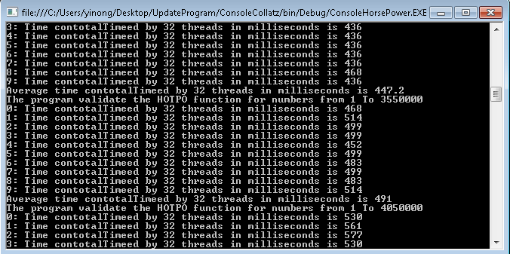
Output (Part)

Slide 49
Multithreading Performance with Communication and Synchronization
The threads in Collatz Conjecture validation program are independent of each other.
How much performance can be improved if communication and synchronization are involved among the threads?

Slide 50
Performance with Thread Communication
Consider the e-commerce system in the diagram
The threads share the multi-cell buffer;
Is the encoder or decoder a bottleneck of performance?
Should the order-processing threads be created in chicken farm thread? What are TBB ideas?
When do we need “Spin Synchronization”?
Main
Decoder
Order
Object
Threads
A thread is created for each order request
Retailer
1
String
String
OrderObject
String
Encoder
. . .
String
Chicken
farm thread
OrderProcessing Thread
Order
Object
Retailer
N
OrderProcessing Thread
Multi-cell buffer
with semaphore
. . .
String
Event subscription
OrderProcessing Thread
Event callback

Slide 51
Summary of Chapter 2
General Issues in Distributed Computing
Resource sharing, deadlock, and deadlock handling
Synchronization
Creating child process in operating system (Unix)
Multithreading in Java (method sync and statement sync)
Multithreading in C# and .Net
Monitors / Lock / Conditional Monitors
Reader/Writer Locks / Mutex / Semaphores
Coordination events: define orders of thread execution
Delegate for creating event service & event-driven programming
Even-driven programming and delegate
Delegates and callbacks
Performance and efficiency of multithreading & multi-cores

